Slide 1
Containers and Kubernetes on Azure
May 2, 2019 — 8:30 AM - 5:00 PM | Detroit, Michigan
Learn, architect, and develop solutions on Azure
#AzureDevDays
for developers, by developers
Learn.
Connect.
Explore.

Slide 2
Microsoft Technology Center
MTC Transformation Academy Sessions
Modern Applications: Full-day briefings and workshops on topics related to Application Development.
Jan 30, 2019 - Azure Developer Day Apr 25, 2019 - Containers & Kubernetes on Azure
Feb 28, 2019 - DevOps on Azure
Mar 28, 2019 - Serverless Workshop Jun 27, 2019 – IoT on Azure Workshop
Big Data: Full-day briefings and workshops on the design and implementation of a robust, scalable, big data platform.
AI and Cognitive Services: Full-day briefings and workshops on the application of AI and cognitive services for business scenarios.
The MTC Transformation Academy - https://aka.ms/mtcacademy

Slide 3

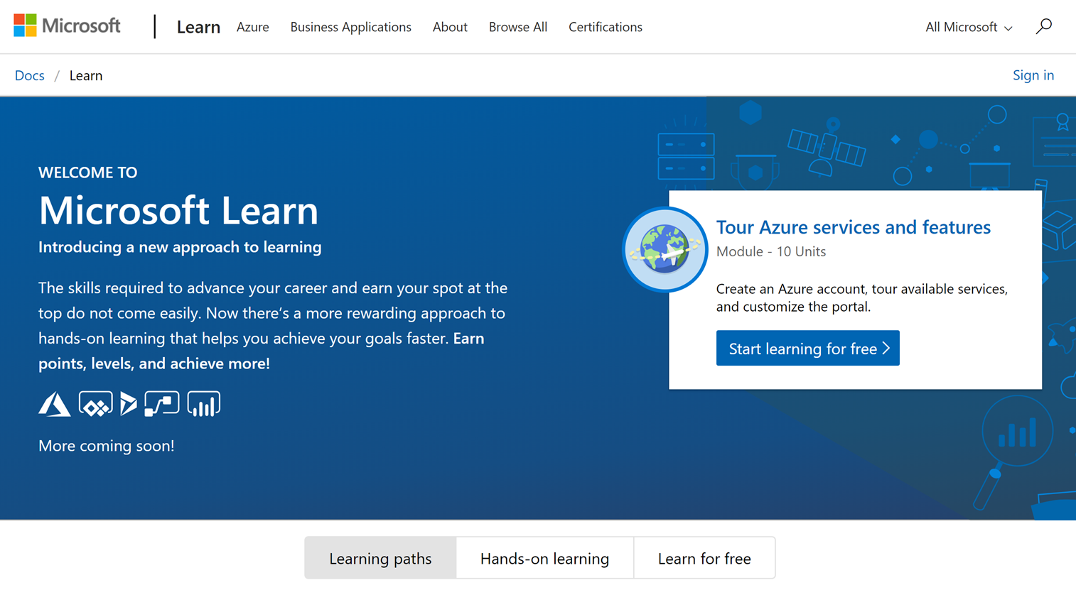
Microsoft Learn
Build your skills fast with free, interactive tutorials at Microsoft Learn
Step-by-step training to fit your schedule
Interactive coding environments for hands-on experience
Earn achievements and recognition for your Azure skills
We provide free Azure sandboxes, free virtual machines, etc. so there is nothing to setup ahead of time.
http://www.Microsoft.com/Learn
Notes:
Introducing Microsoft Learn – the Best place to start learning Microsoft technologies – Free!
Quickly build skills: interactive, step-by-step bite-size tutorials
Learn by doing: browser-based interactive coding environments for hands-on experience. Free fixed-time access to create and manage Azure resources - no credit card required.
Earn recognition: Track progress, check knowledge, and validate deployments to earn points, levels, achievements, and trophies
Learning aligned to new role-based certifications: easier for you to prepare for certification and be recognized as a leader in Microsoft technologies
Multiple modes of learning: learn in way best for you. select from free self-paced quick tutorials and hands-on learning, to structured online courses free from Pluralsight and instructor led classes from learning partners. Get started by selecting a Learning Path that is closest to your role, e.g. Business Analyst , Azure Developer , Azure Solution Architect . Regarding the individual modules: You can start with the basics such as Tour Azure services and features or go deep with something like Create serverless applications.

Slide 4
Content
https://github.com/MTCDetroit/Academy-Events

Slide 5
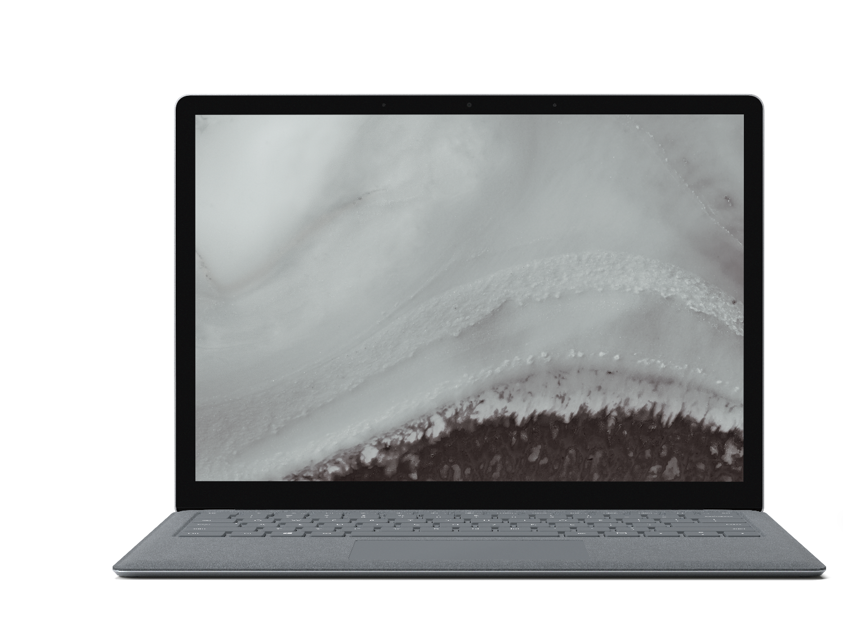
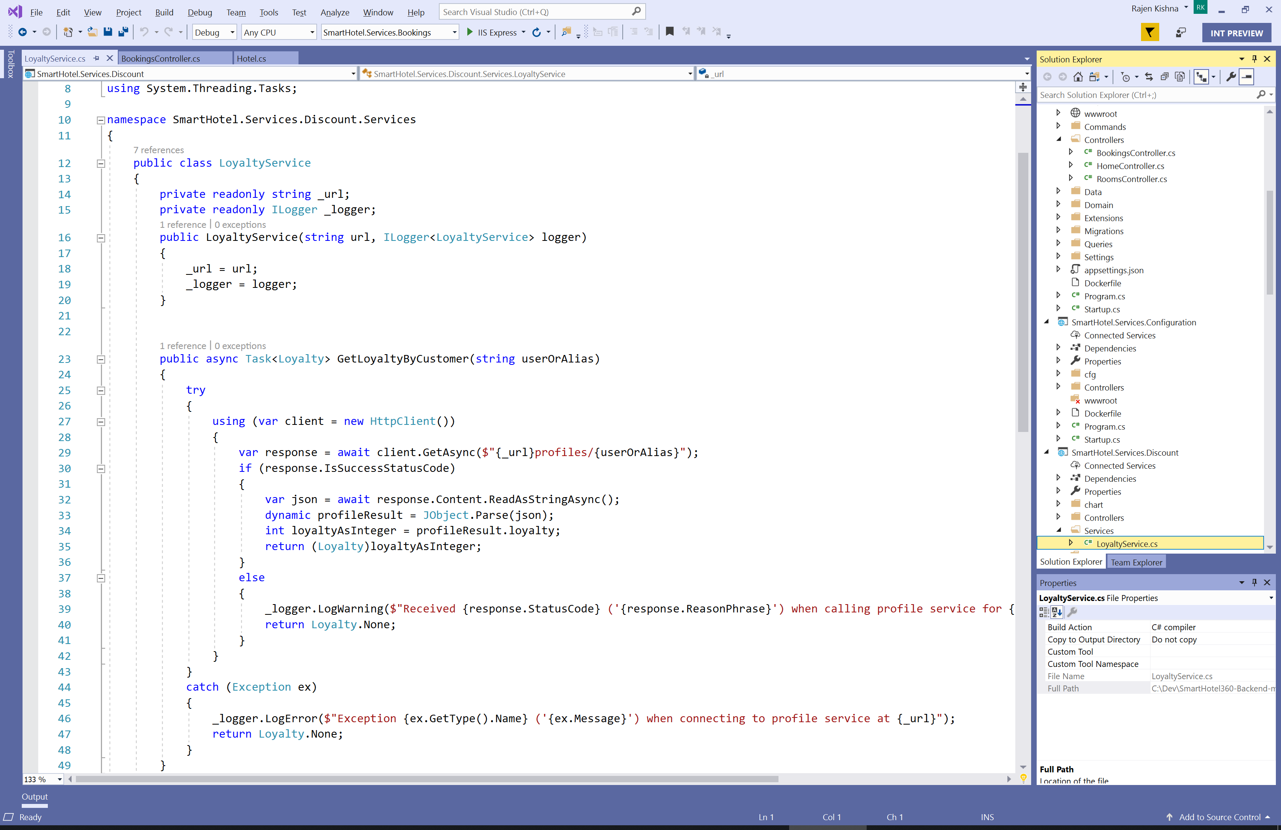
Visual Studio 2019
Personal and team productivity
Modern development support
Continuous innovation
UI Refresh & Search Improvements
Health and Code Cleanup
Code editing with IntelliCode
Collaborate with Live Share & GitHub integration
Improve code quality with historical debugging and live unit testing
.Net Core 3
Learn More: https://visualstudio.microsoft.com/

Slide 6
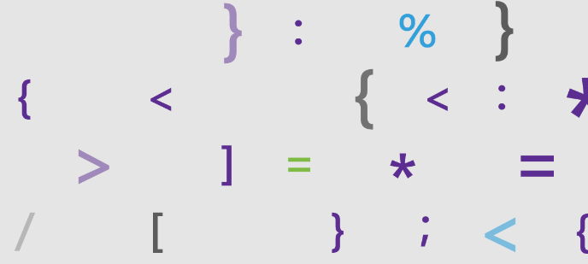
Visual Studio 2019
Launch Event
https://launch.visualstudio.com/

Slide 7

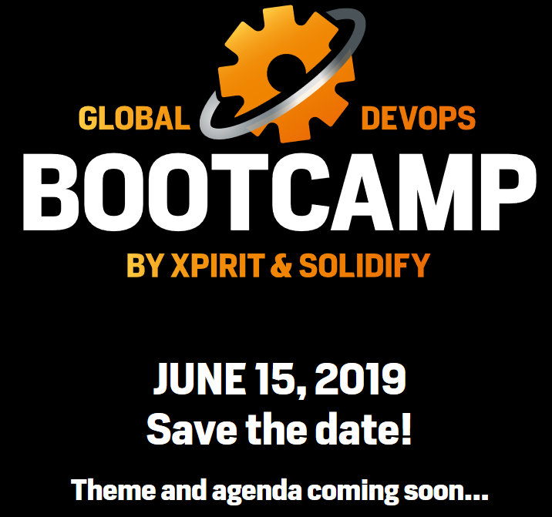
Global DevOps Bootcamp
2019 Detroit
FREE EVENT
Microsoft Detroit
One Campus Martius
Suite 500
Detroit, MI 48226
Saturday, June 15, 2019
10:00 AM to 5:00 PM (EDT)
The Global DevOps Bootcamp takes place once a year on venues all over the world.
http://globaldevopsbootcamp.com/

Slide 8
Agenda
8:30 – 9:00 am | Check-in and Breakfast
9:00 – 9:30 am | Introduction to Serverless Computing
9:30 – 10:30 am | Azure Logic Apps
10:30 – 10:45 am | Break
10:45 – 11:45 am | Azure Functions
11:45 – 12:30 am | Lunch
12:30 – 1:30 pm | Cognitive Services
1:30 – 2:00 pm | Event Grid
2:00 – 2:45 pm | API Management
2:45 – 3:00 pm | Break
3:00 – 5:00 pm | Hands-on Labs

Slide 9
Agenda
8:30 – 9:00 am | Check-in and Breakfast
9:00 – 9:30 am | Introductions and Welcome
9:30 – 10:30 am | TBD
10:30 – 10:45 am | Break
10:45 – 11:45 am | TBD
11:45 – 12:30 am | Lunch
12:30 – 1:30 pm | TBD
1:30 – 2:00 pm | TBD
2:00 – 2:45 pm | TBD
2:45 – 3:00 pm | Break
3:00 – 5:00 pm | TBD

Slide 10
Resources
Slides, Labs, Contact Info
https://github.com/MTCDetroit/Academy-Events
Free Azure Trial
http://aka.ms/FreeAzure
Microsoft Technology Center Events
https://aka.ms/mtcacademy
Azure DevOps Hands on Labs
https://www.azuredevopslabs.com/
Team System Café
www.teamsystemcafe.net/resources

